Slide 1

Decoding of motor termination in Imaged movement
Elisabetta Pagliara, Marco Milano, Giammarco Pacifico (Project 1)
Brain Computer Interaction – EE514

Slide 2

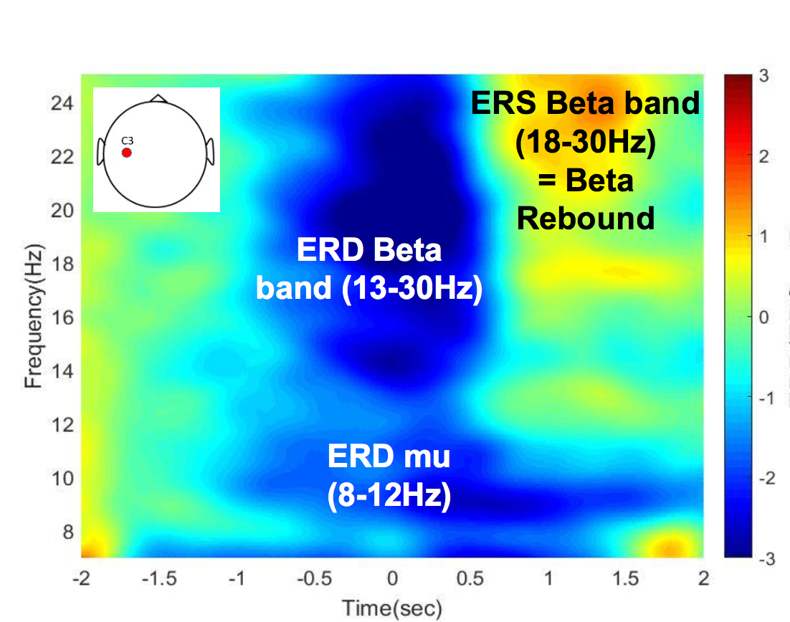
Project Description
Performing Kinesthetic Motor Imagery (MI)
What happens to the brain activity (record from 16 electrodes-cap)?
Why studying Kinesthetic MI?
Beta rebound could be used to decode when the user wants to stop motor imagery
Notes:
It has been observed that preceding movement onset and during movement execution, a decrease of power can be detected in mu band (8-12 Hz) as well as an increase of power in beta band (13-30 Hz), called beta rebound, over the contralateral sensorimotor cortex.
This is what we ideally would like to achieve

Slide 3
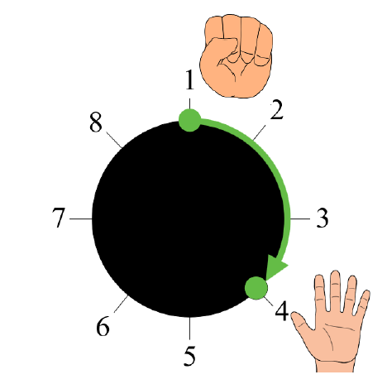
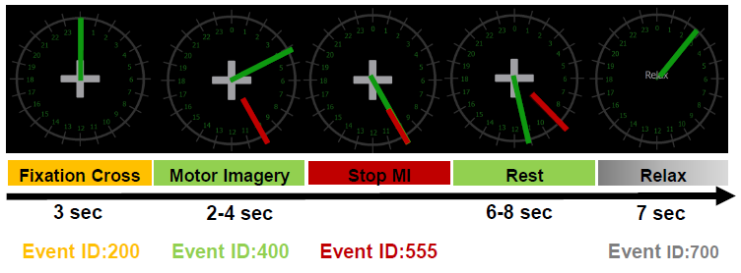
Protocol
START
END
4 runs (cue-based) of 30 trials of 10 sec plus 7 sec of relax each.
Beta rebound
Notes:
Changes in the brain rhythms are observed in the sensory-motor area of brain during planning and execution of movements. Indeed, it has been observed that preceding movement onset and during movement execution, a decrease of power can be detected in mu band (8-12 Hz) as well as in beta band (13-30 Hz) over the contralateral sensorimotor cortex (Pfurtscheller & Lopes Da Silva, 1999). Additionally, the beta band presents an increase of power known as the beta rebound, which generally occurs after movement termination and that can last for a second (Thatcher, Sato, Kufta, & Hallett, 1994). This beta rebound does not necessarily depend on motor cortex output and muscle activation since this beta rebound has been also reported in motor imagery (MI) and it is thought to reflect a short-lasting state of deactivation or inhibition of motor cortex networks

Slide 4
EEG correlates - Methods

Slide 5
Filtering and epoching
Concatenation of all runs for each subject
Temporal filtering: 4-th order Butterworth band-pass filter [ 5, 40] Hz
Comparison of two different spatial filters: Laplacian filter and CAR filter
Epoching of the data based on the event type and the chosen time before and after the selected event
Baseline (EventID 200): [-3 , 3] s
Motor Imagery initiation (EventID 400): [-4 , 2] s
Motor Imagery termination (EventID 555): [-3 , 3] s
Notes:
Temporal filtering: l’abbiamo provato ma poi abbiamo visto che non c’era differenza. In realtà lo spectrogram lo fa già da sé.

Slide 6
PSD Analysis
Pwelch on CAR data to obtain the periodogram to compare baseline and Motor Imagery (Parameters: win=512, noverlap=0.5*512, frequency=500 Hz, sample rate=512 Hz)
Spectrogram on the most relevant channels
(Paramters: win=512, noverlap=512-32 , freq=5: 0.1: 40 Hz)
Grand average over the three subjects
Topoplot in alpha band (8-12 Hz) and beta band (13-30 Hz) for both onset and offset, using a 2-seconds window [-1:0.25:1] with respect to the event alignment
Notes:
Cos’è win, cos’è noverlap, cos’è frequency?
Win= durata in time point della window interna al pwelch
Noverlap= shift interno del pwelch
Frequency= passa-alto

Slide 7
EEG correlates - Results

Slide 8
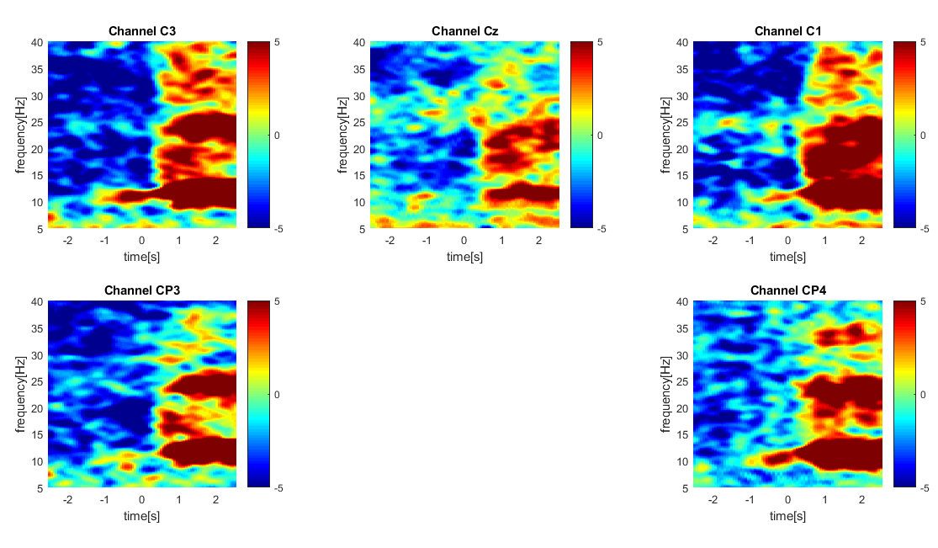
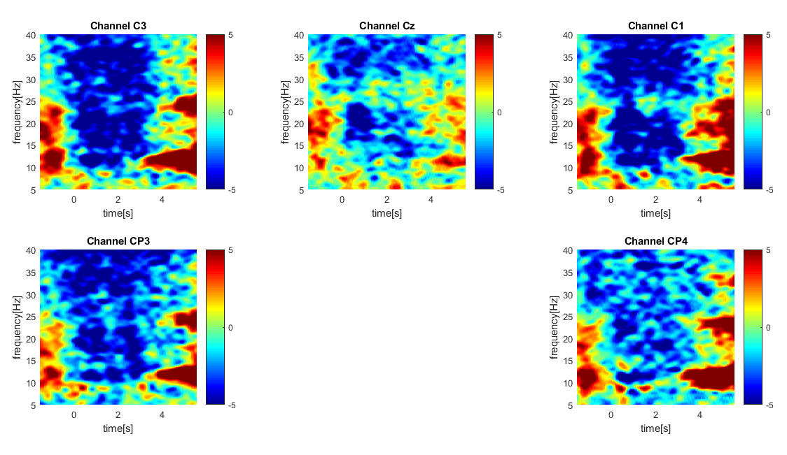
Spectrogram offset and onset CAR - ak4
The presence of the beta rebound is clearly visible for C1, C3 and CP4 but a sort of “alpha rebound” is also present at lower frequencies
Notes:
Per ogni canale: per ogni epoca:
Spectrogram baseline, spectrogram MI. Media per ogni frequenza (mediamo tutti i time samples di quella frequenza). Poi dividiamo la rispettiva colonna della motor imagery

Slide 9
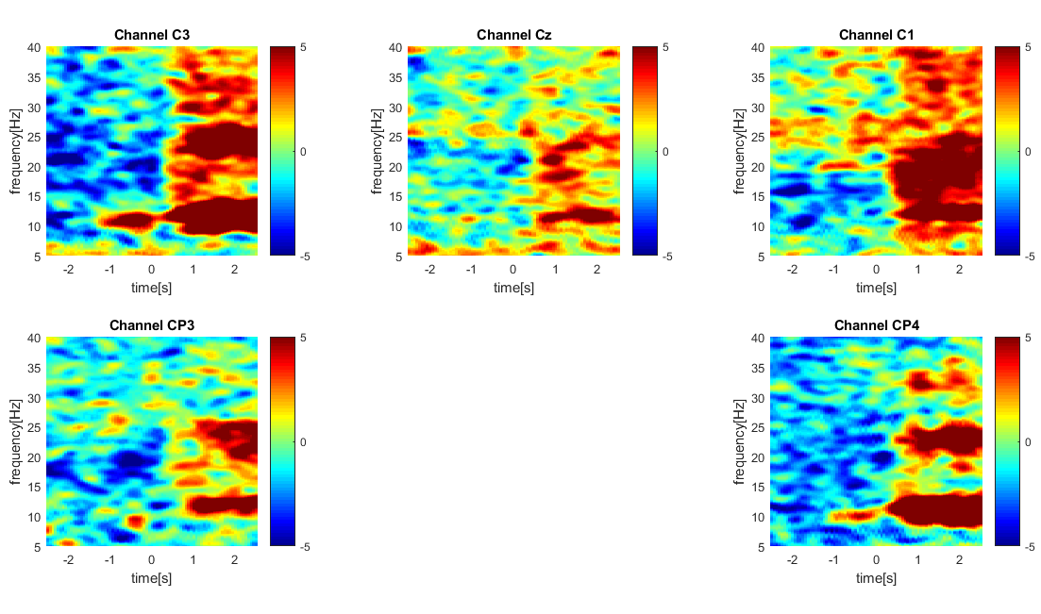
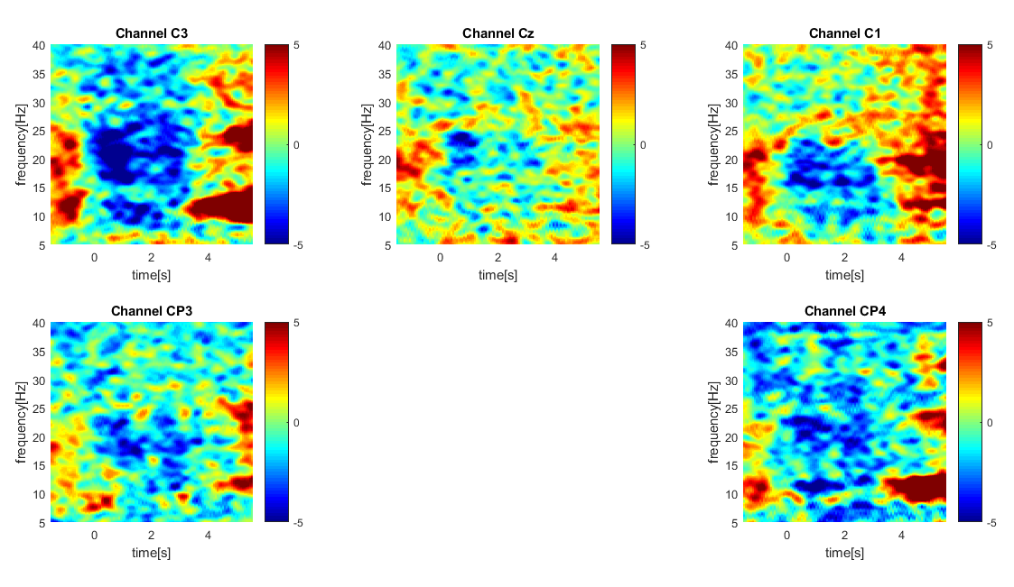
Spectrogram offset and onset Laplacian - ak4
Compared to CAR filter, Laplacian shows less evident representation of ERD events in all the channels. Therefore, CAR has been chosen for the subsequent analyses.

Slide 10
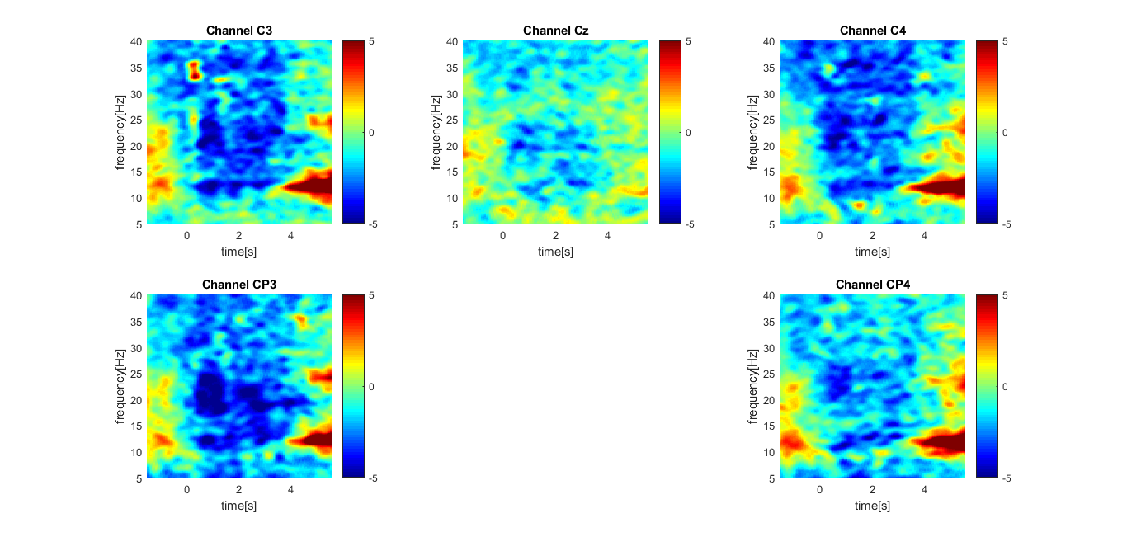
Grand average over all three students - CAR (onset)
Events (ERD in blue and ERS in red) are visible in all the grand averaged plots for onset
Notes:
Grand average: media su matrici punto per punto

Slide 11
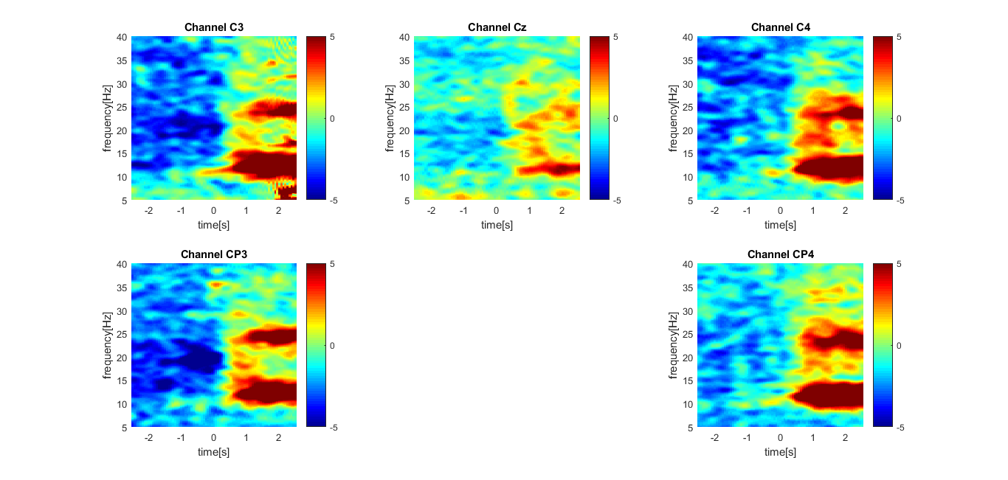
Grand average over all three students - CAR (offset)
Events (ERD in blue and ERS in red) are visible in all the grand averaged for the offset
Notes:
As expected, the beta rebound is particularly visible with the offset boundaries.

Slide 12
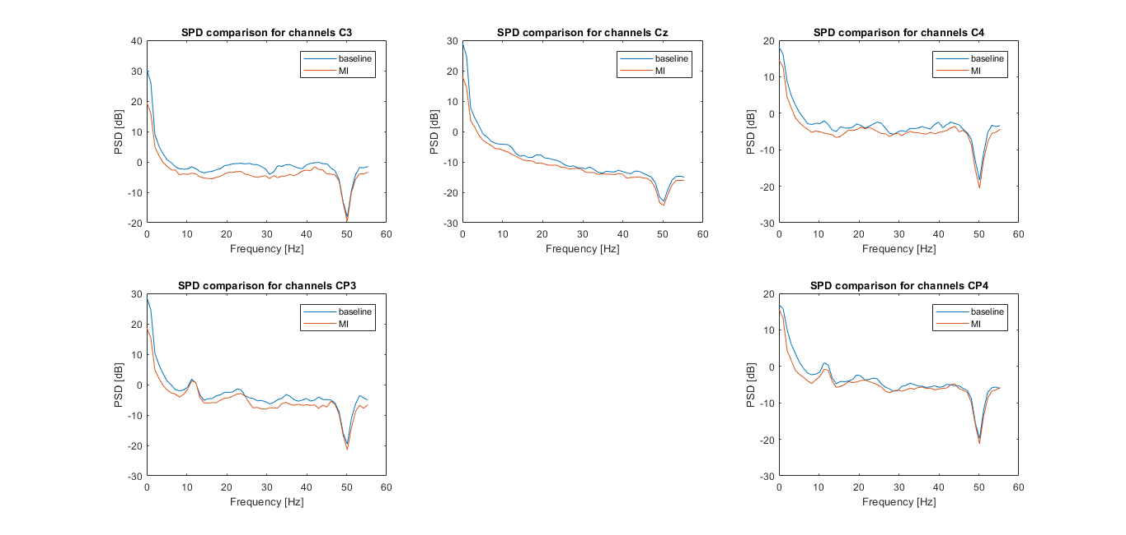
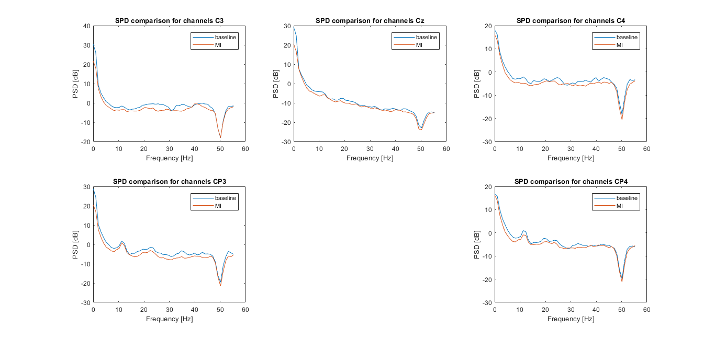
Periodogram (Pwelch) CAR offset/onset ak5
The periodogram shows the PSD depending on the frequency. We only showed the region of interest until 50 Hz. The presence of two bumps in the alpha band can be seen in the most relevant channels when comparing baseline and MI
Notes:
BIG TYPO IN THE FREQUENCIES!!
Decrease in alpha and in beta.
Per ogni canale pwelch baseline and pwelch MI
10*log10(PSD())

Slide 13
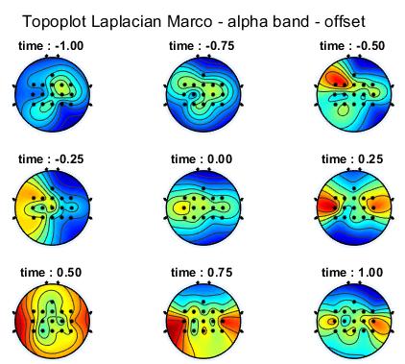
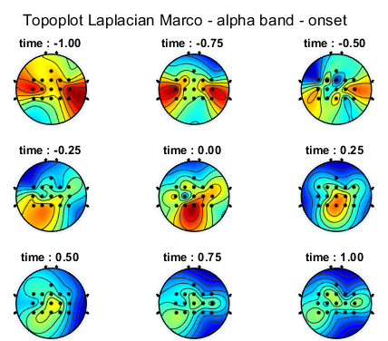
Topoplot alpha band - ak4
A decrease in the alpha band can be observed after the onset alignment and during the motor imagery. Moreover, a considerable increase is visible after the MI termination, during the relax phase

Slide 14
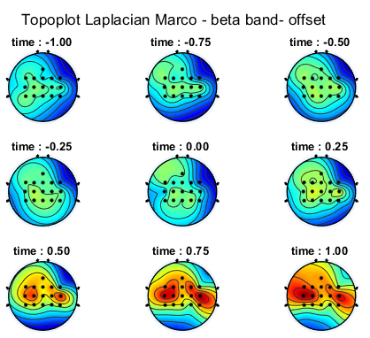
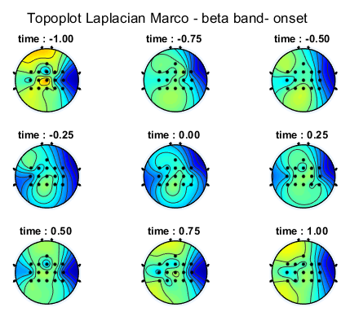
Topoplot beta band - ak4
The presence of the beta rebound is evident after the MI termination while lower power is visible during the MI initiation

Slide 15
Pattern Classification - Methods

Slide 16
Structuring the data
4 runs (4 ∙ 30 = 120 trials) per subject
Spatial filtering: CAR. Temporal filtering: /
Spectrogram on the whole signal (for each run)
[4:2:40] Hz (19 intervals)
16 channels
Division of the signal into 1 second-long windows with a shift of 0.0625 s
=> 304 different features (PSD)
Notes:
Dire che Marco aveva 3 run (però non cambia niente).
L’abbiamo fatto per avere più samples

Slide 17
Structuring the data (2)
Epoching on :
Motor Imagery Initiation - Event ID 555 [ -2,0 ] s
Motor Imagery Termination - Event ID 555 [ 0.5,2.5 ] s
We obtained 17 windows for each trial for each type of event (i.e. 17 ∙ 2 = 34)
Concatenation of the runs
=> 120 ∙ 34 = 4080 samples with 304 features
Classifier had to distinguish between two classes: ERD (MI initation) and ERS (MI Termination)
(Manually (re)assigned label 400)
Notes:
In che senso epoching.

Slide 18
Cross-validation and feature selection
Divided into 75% training set - 25% test set
10-fold CV on training but with temporal-based partition (ordered trials)
Normalization with zscore
Hyperparameters:
Type of classifier (linear, diaglinear, diagquadratic)
Number of features
=> Feature selection with Fisher score
=> Selection of the hyperparameters based on class error (of course on validation fold!) averaged over folds
Notes:
Non abbiamo usato cvpartition. Quadratic non andava proprio

Slide 19
Evaluation of the capability
Retraining on the whole 75% training + validation set (but without CV), with the hyperparameters found in the CV
For features: only the number of features is fixed, but the actual features to take into account are determined by re-training
=> Test on the separate unseen 25% test set
Metrics:
- ROC curve
- confusion matrix
- class error

Slide 20
Pattern Classification - Results

Slide 21
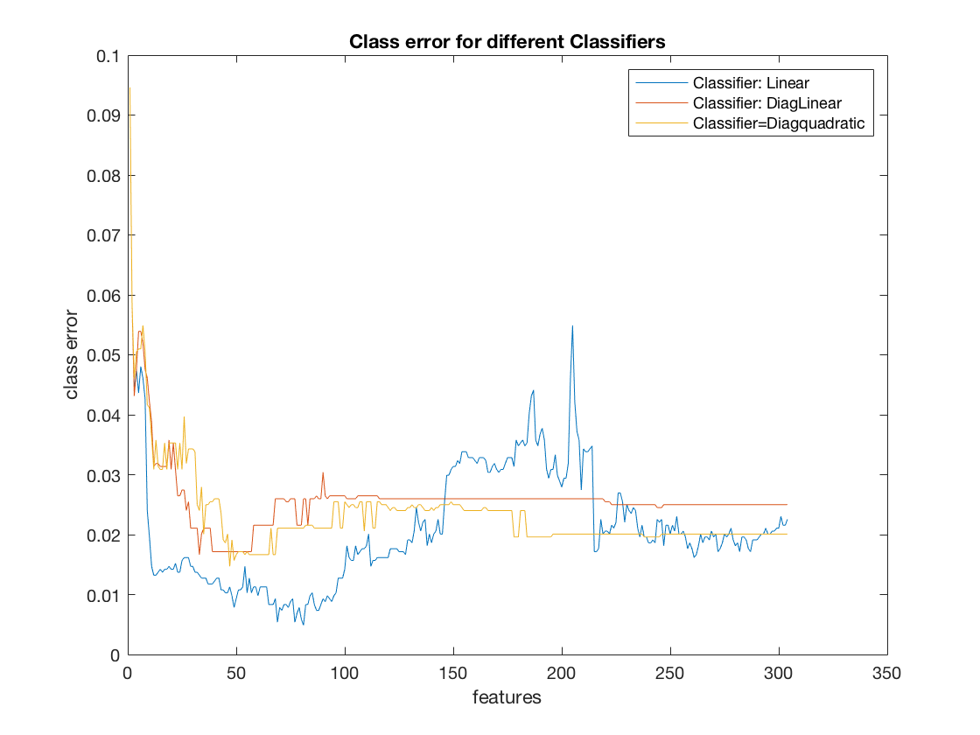
Hyperparameters selection
Hyperparameters selected:
Classifier type:
N_{sel} =
linear
(for all 3 subjects)
13 (for ak4)
20 (for ak5, ak6)
Class errors - ak4
Notes:
Per ak5 e ak6 abbiamo deciso noi, come ci ha detto Bastien, di limitare il numero di feature a massimo 20

Slide 22
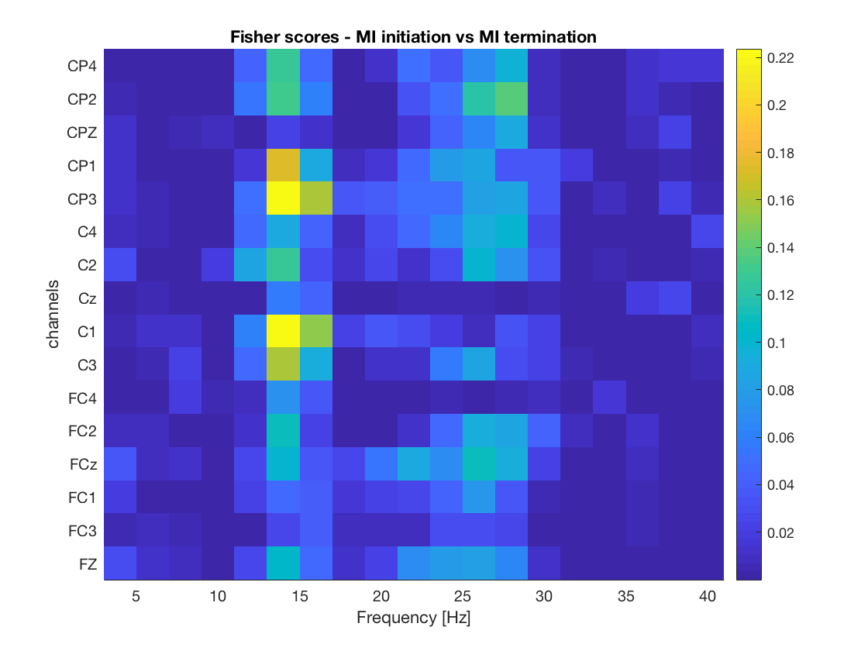
Fisher score – ak6
rankfeat on 75% (re-training on train+validation)
The most discrimant features appear to be in the mu band, for channels: C1, C3, CP1,CP3

Slide 23
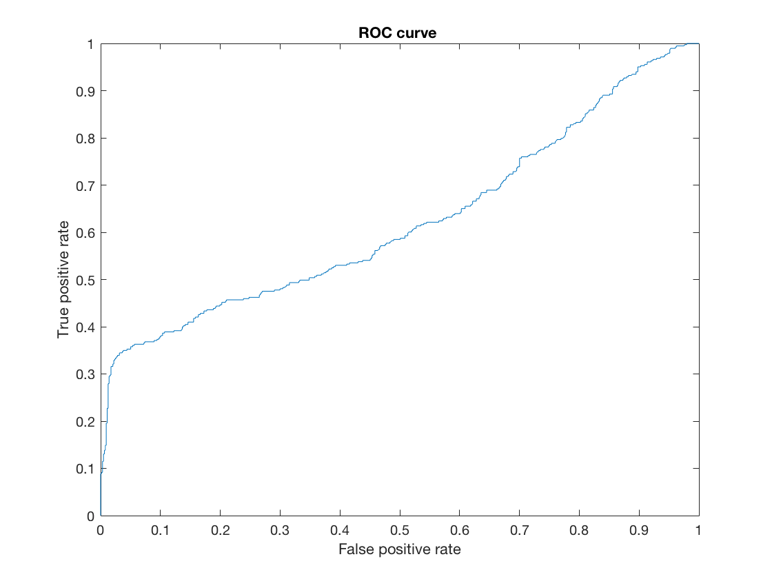
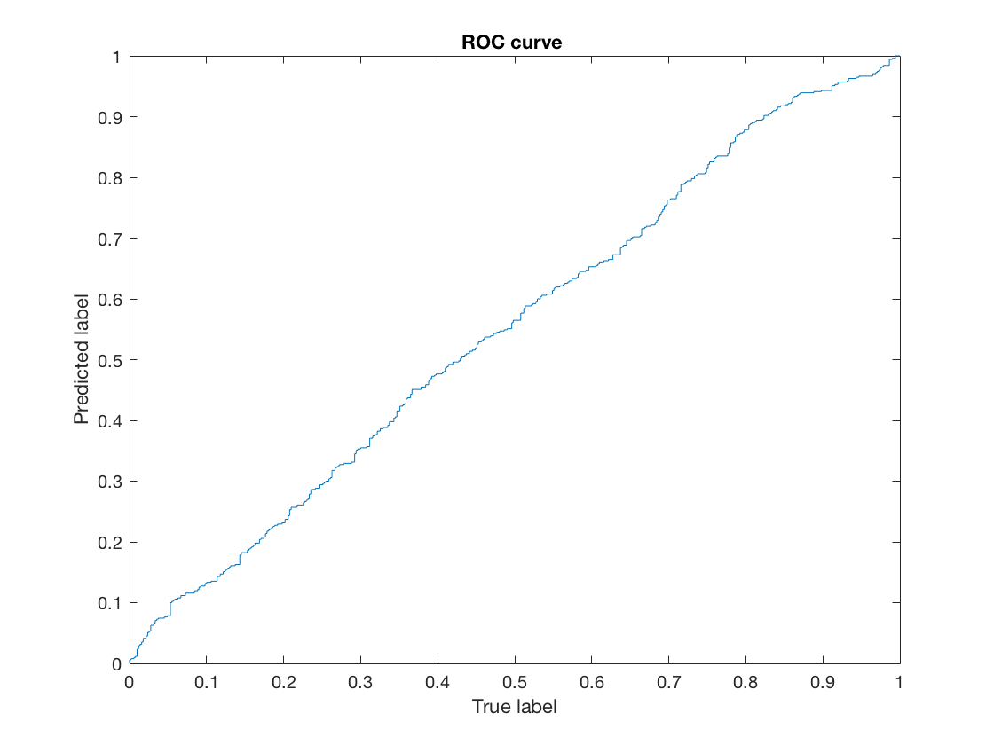
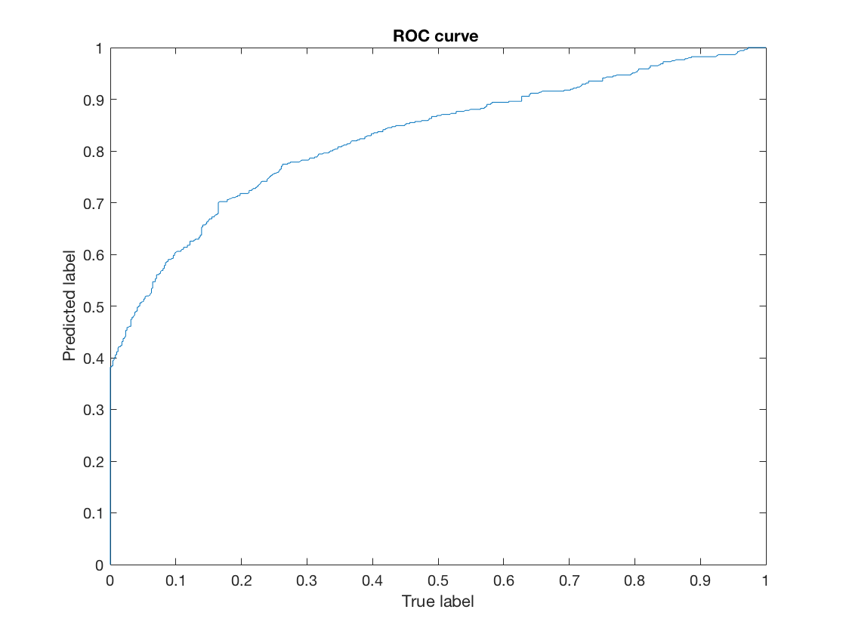
Metrics for capability assessment: ROC curves
ak4
ak5
ak6
Only the decoder for subject ak6 shows a good performance
Notes:
For ak5 è random. Very low performance

Slide 24
Metrics for capability assessment: class error and confusion matrix
ak4
ak5
class error: 0.362
class error: 0.463
confusion matrix:
574 | 63
239 | 144
confusion matrix:
316 | 194
278 | 232
ak6
class error: 0.238
confusion matrix:
420 | 90
152 | 358

Slide 25
Discussion

Slide 26
Summary
For all the participants the channels of interest (CP3, CP4, C3, C1) have the highest activity during MI termination
Kinesthetic Motor Imagery shows for all the participants the expected pattern of brain activity
Beta rebound is almost always accompanied by mu rebound

Slide 27
Major issues encountered/Improvements
The decoder shows higher performance for one participant with respect to the others
Mean class error over CV folds with respect to the number of features shows a monotonic decreasing trend
It is possible that some problems in re-ordering the features for Fisher scores maps were present in the code

Slide 28
Major issues encountered/Improvements
Extraction of the epochs (backward/forward) may also have affected the results
Principal Component Analysis (we tried to implement it but we did not get good results)
Notes:
Abbiamo provato, ma non c’erano grandi differenze. Prima PCA poi rankfeat.

Slide 29
…online!
The online trial consists of using the test set by taking it through a buffer window of 512 time samples moved by 32 time steps at a time.
Inside this buffer window several steps need to be done:
Preprocess of the signal using CAR
Pwelch for each channel -> 304 features (16x19 matrix)
Classifier:
Normalization
Feature selection -> take the best features from the training phase
Prediction and classification: based only on the selected features (posterior prob.)
Evidence accumulation -> based on the posterior probability from the prediction step

Slide 30
Thank you for your attention!
Any questions?

Slide 31
Additional results

Slide 32
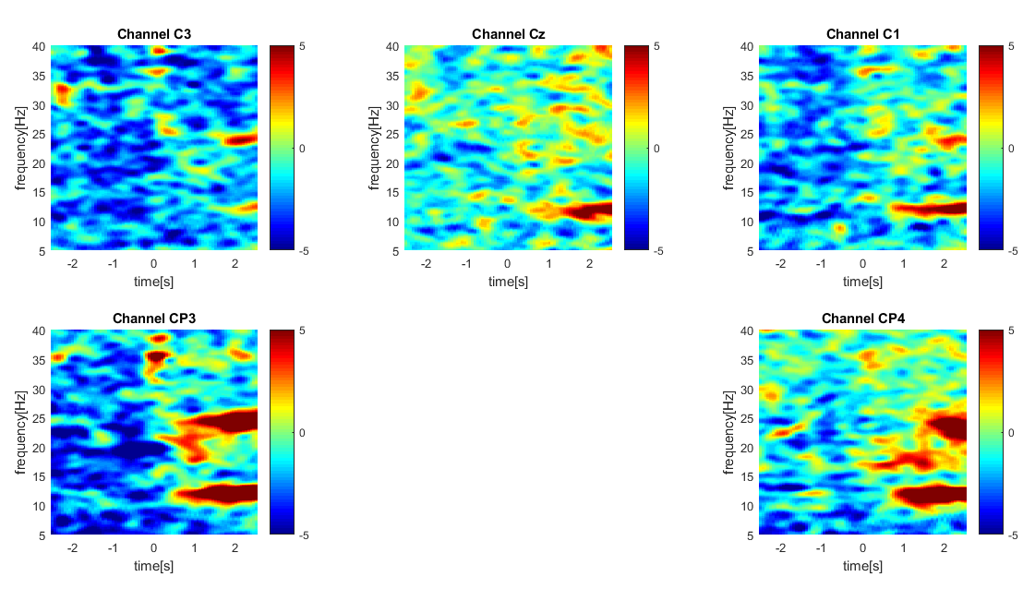
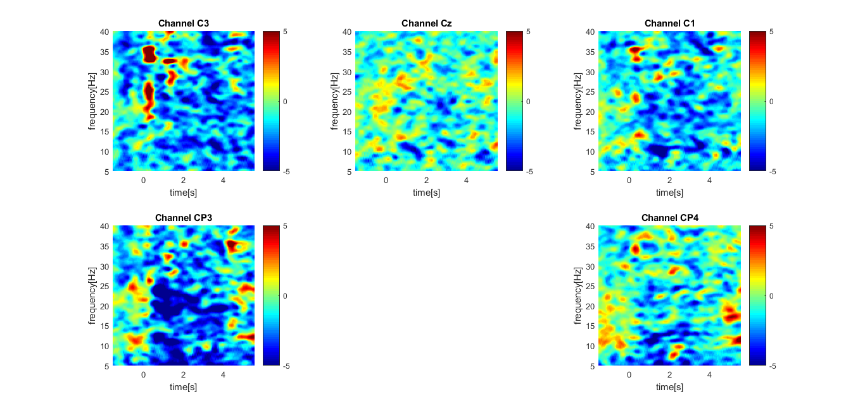
Spectrogram offset and onset CAR - ak5

Slide 33
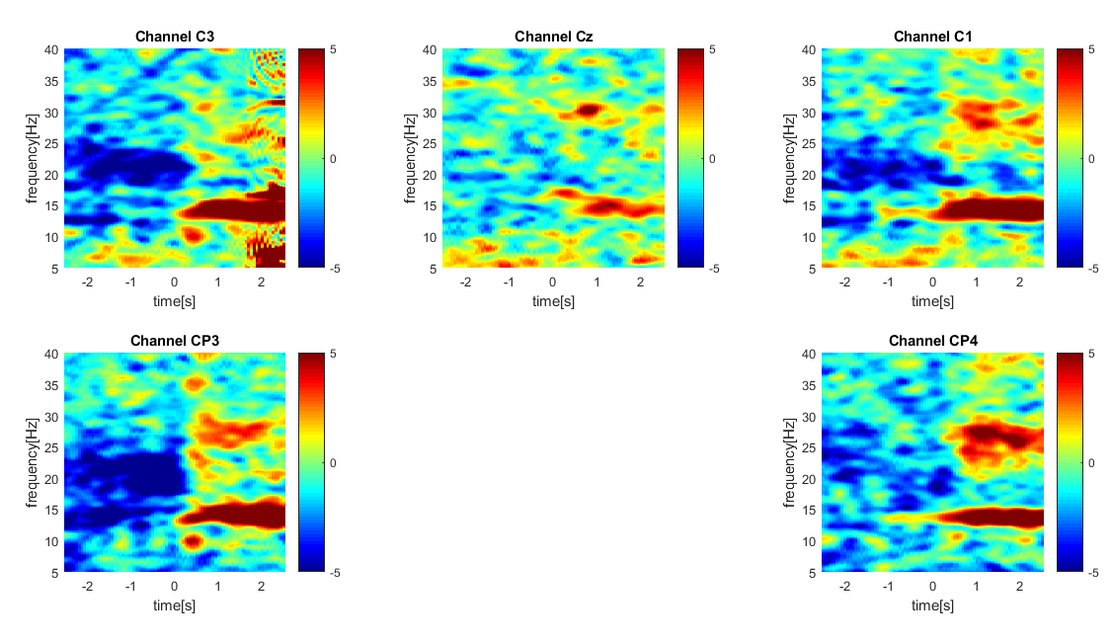
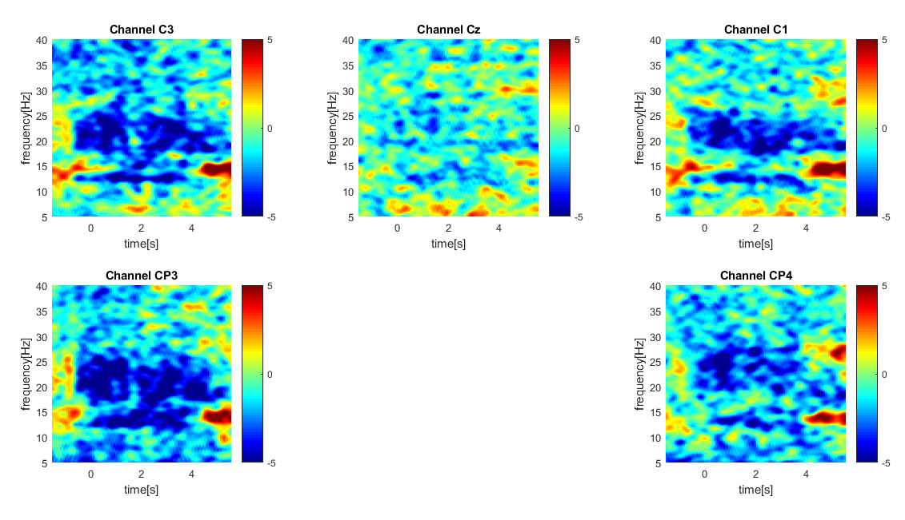
Spectrogram offset (left) and onset (right) CAR - ak6

Slide 34
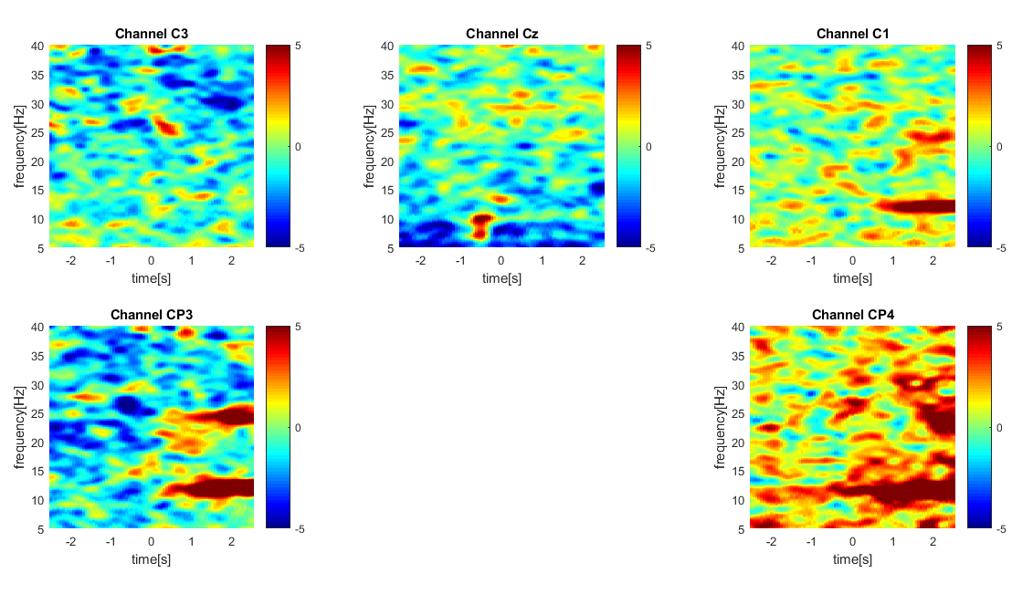
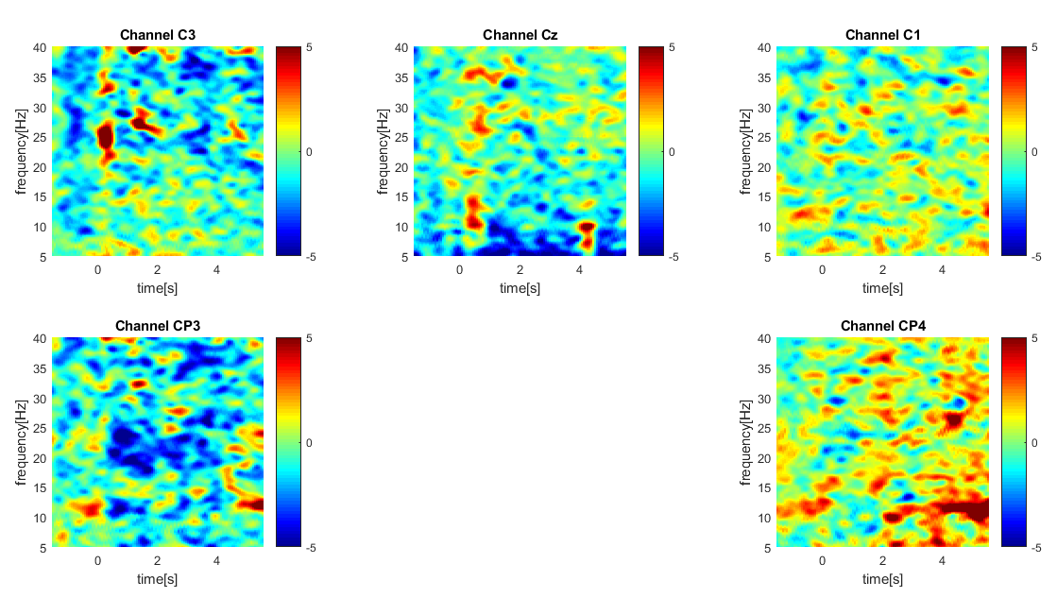
Spectrogram offset and onset Laplacian - ak5

Slide 35
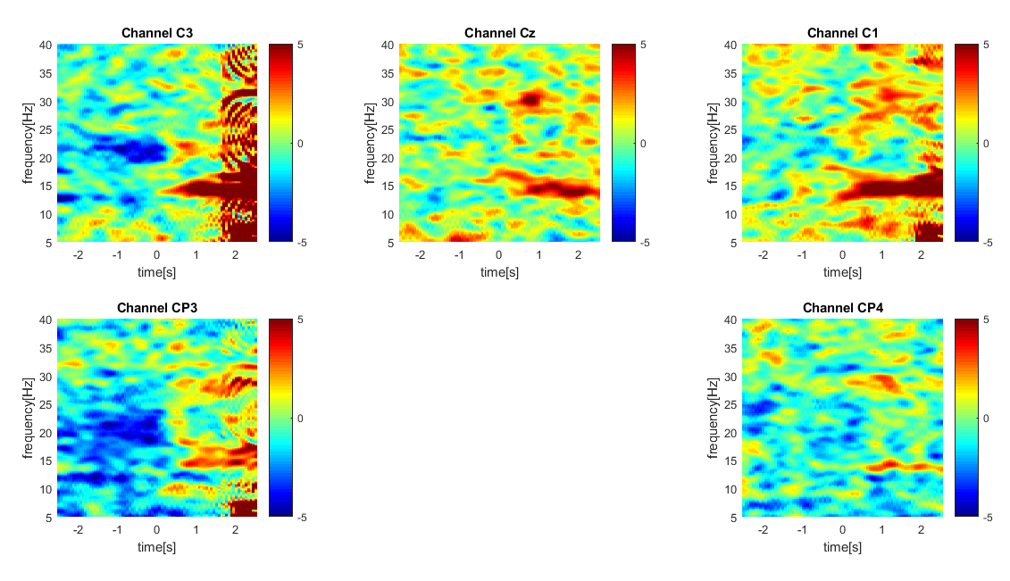
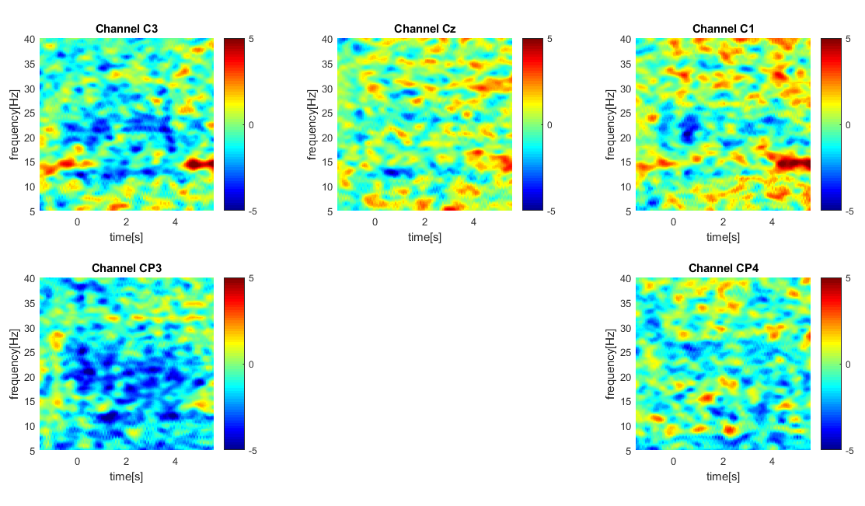
Spectrogram offset and onset Laplacian - ak6

Slide 36
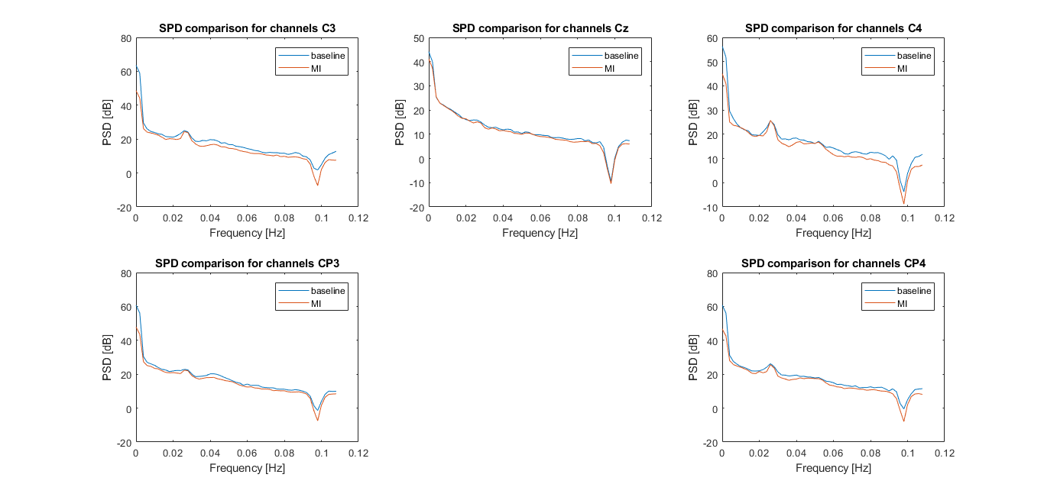
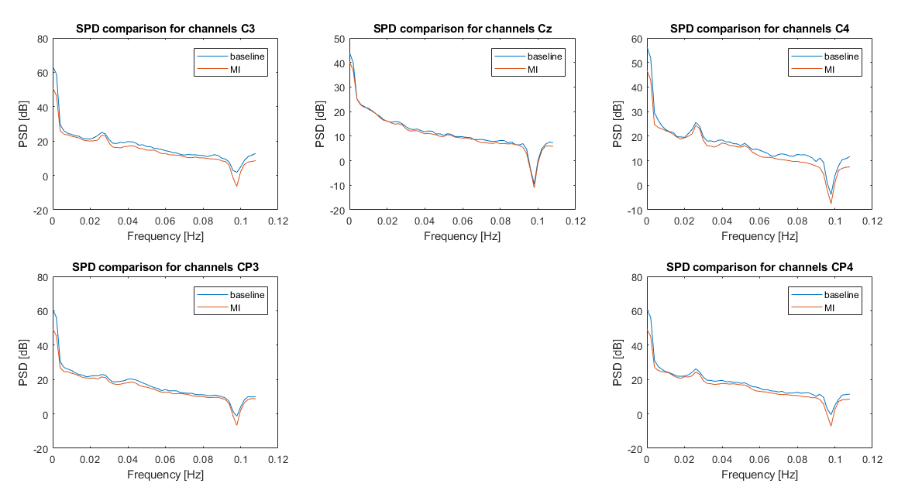
Periodogram (Pwelch) offset/onset ak6

Slide 37
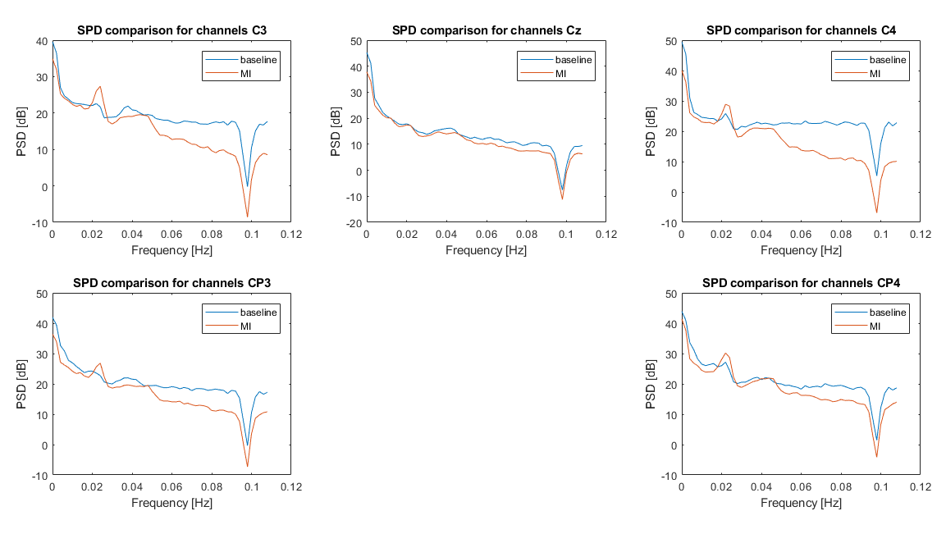
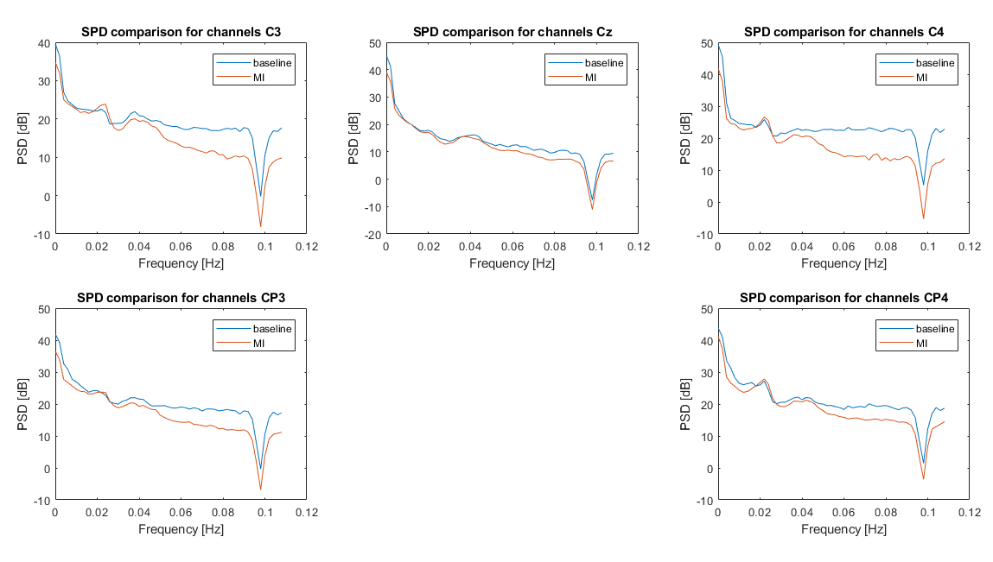
Periodogram (Pwelch) offset/onset ak4

Slide 38
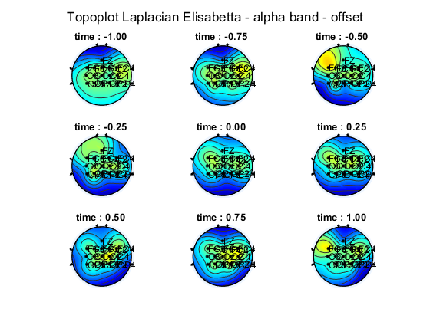
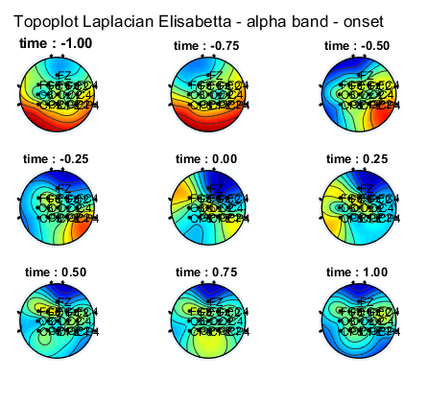
Topoplot alpha band - ak6

Slide 39
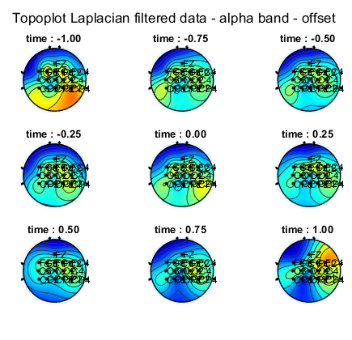
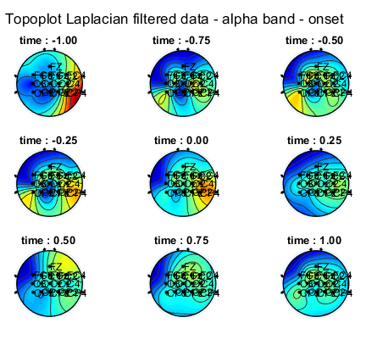
Topoplot alpha band - ak5

Slide 40
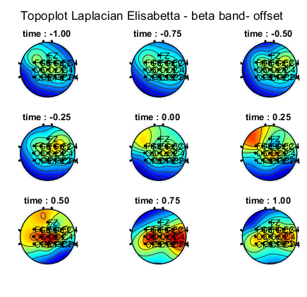
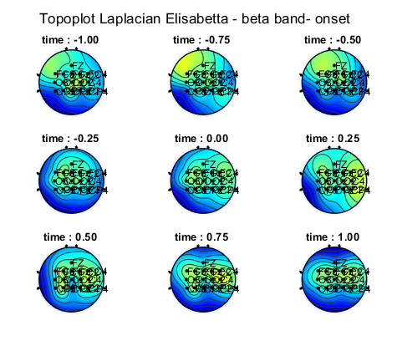
Topoplot beta band - ak6

Slide 41
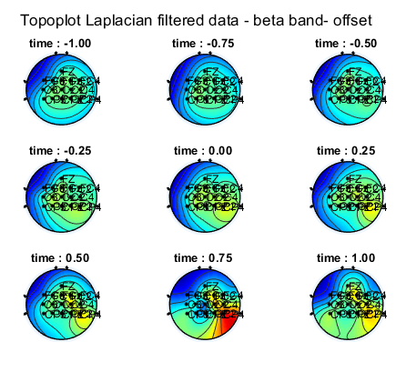
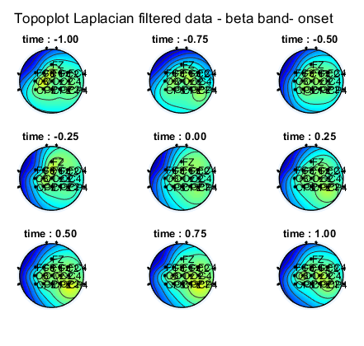
Topoplot beta band - ak5

Slide 42
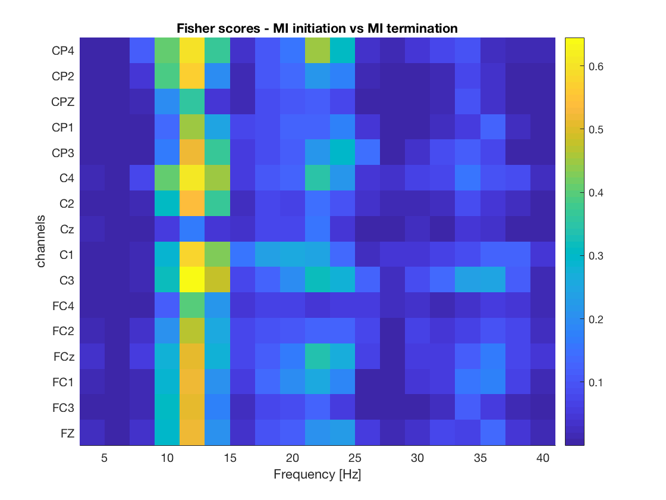
Fisher score – ak4

Slide 43
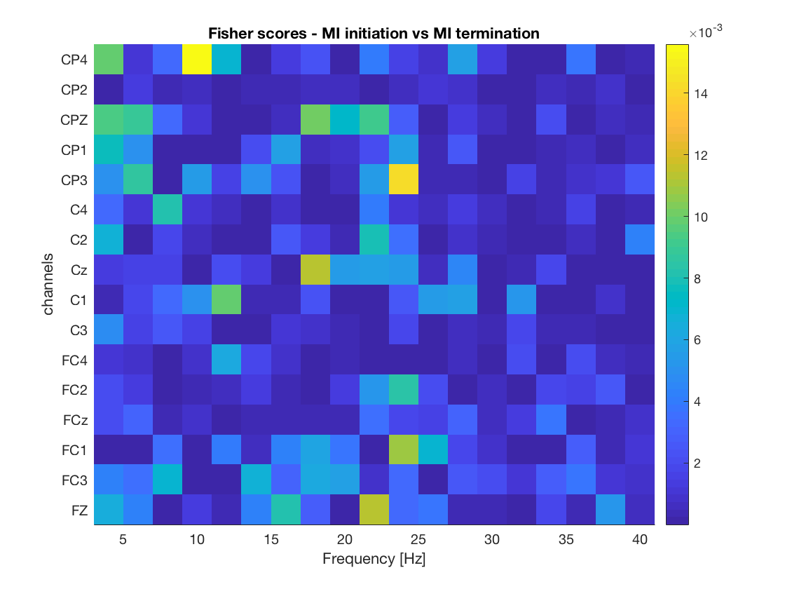
Fisher score – ak5

Slide 44
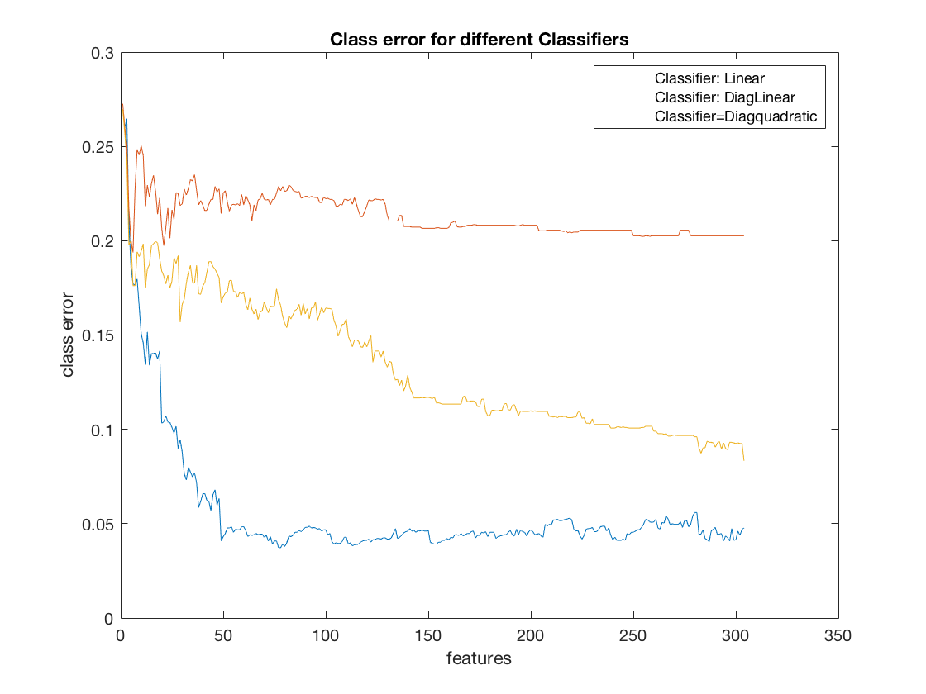
Class errors on CV folds – ak 5

Slide 45
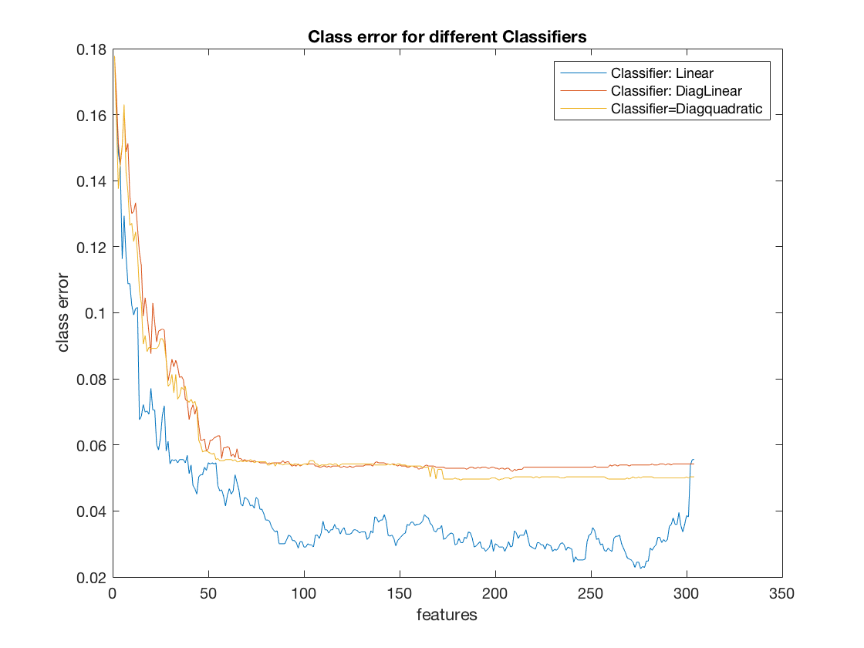
Class errors on CV folds – ak 6

